Slide 1


Python Webapp Programming
Questionnaire app with Django
--Form, Django edit views

Slide 2
Add new function for user to add comment or feedback
Before we start to let user participate the questionnaire, we first develop the function for user to add comment/feedback.

Slide 3
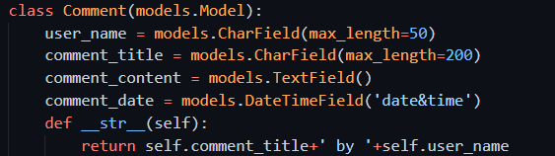
Add model to store the comment in DB

Slide 4

Register DB to admin app, readonly

Slide 5
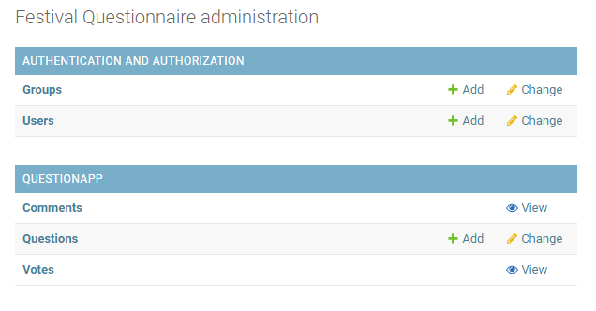
Check the db
PS> QuestionPrj
PS> pipenv shell
PS> py manage.py makemigrations QuestionApp
PS> py manage.py migrate
Open admin and check

Slide 6
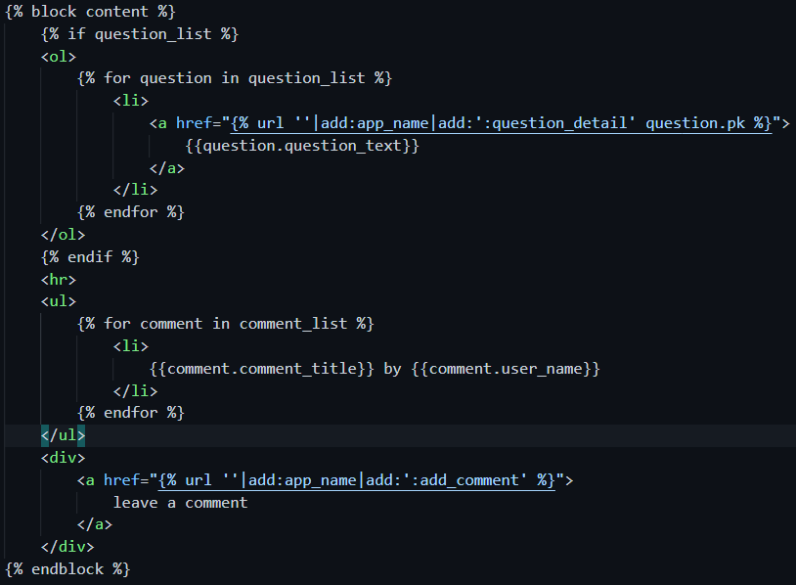
Add one comment button to the home page
Add button which links to add comment
Also added showing all comment information in the homepage, after the question list.

Slide 7
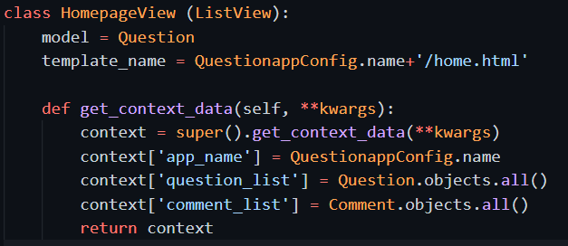
Homepage view need update with more context info
Need add comment list, so that the template can process and get all comment list info

Slide 8
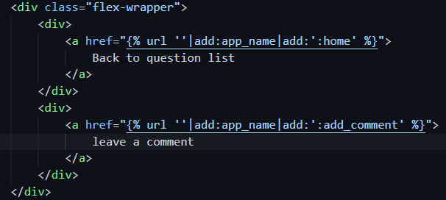

Add one comment button to the result page
Add the class flex-wrapper, for the added clickable of leave a comment

Slide 9
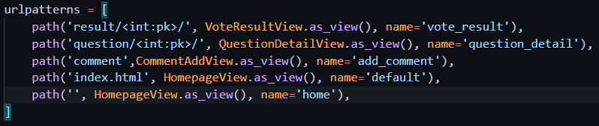
Add url conf

Slide 10
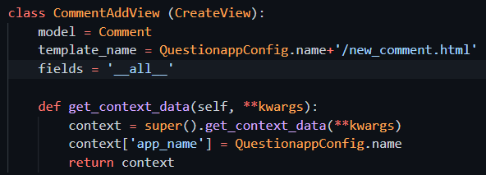
Add view for add comment page
It is using the Django.views.generic.edit, the CreateView. Other views include UpdateView, DeleteView.

Slide 11
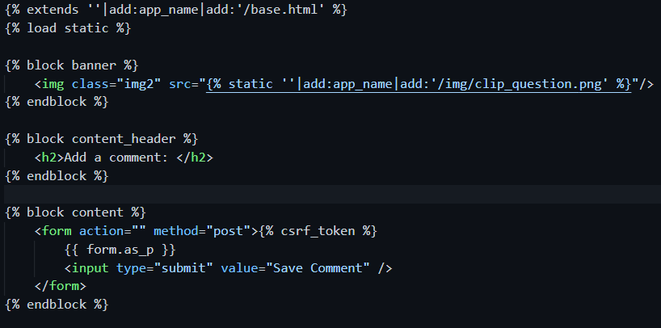
Add template for add comment
The template will use form for user to input and post

Slide 12
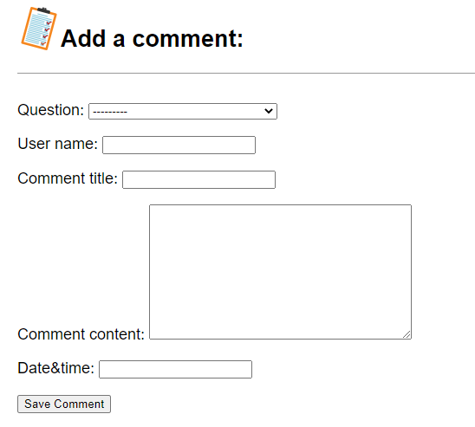
Check the result
We got the form, but for the datetime field, it is like a text we must key in information manually.
The format must be exactly like what shown in picture,
YYYY-MM-DD HH:MM:SS
2020-09-01 20:20:20

Slide 13

But still another issue
When finish a POST action, the webserver should return back a new URL for the browser to view.
As shown by the error information from Django, we can do this by define get_absolute_url for the model which we are modifying. This URL will be the success url for the user after he add the new comment.
Then we add the get_absolute_url, make it go back to the homepage after success submit.

Slide 14
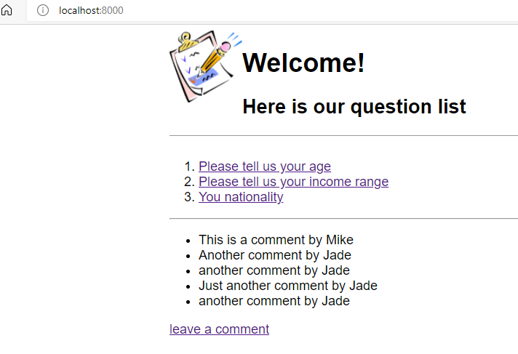
Check the result
After submit a form then it will go back to show the homepage, with the comment updated.

Slide 15
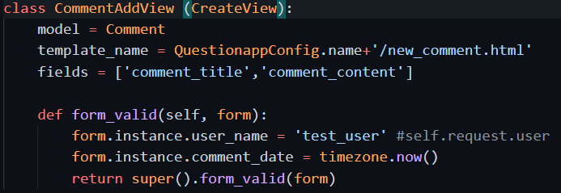
User_name and datetime information
The field of user_name and datetime, should not be input by the user.
User_name should get from the user signup / login information
Datetime should be automatically added when user submit.

Slide 16
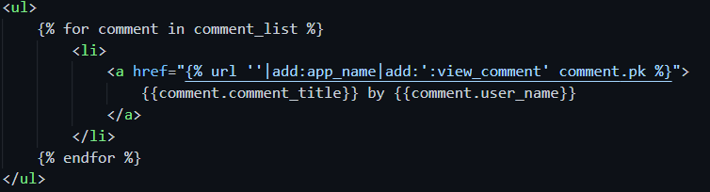
Add edit comment function
At home page for each comment add link to click and see detail of comments.
at detail comments add edit the comment and delete the comment, two button at the bottom

Slide 17
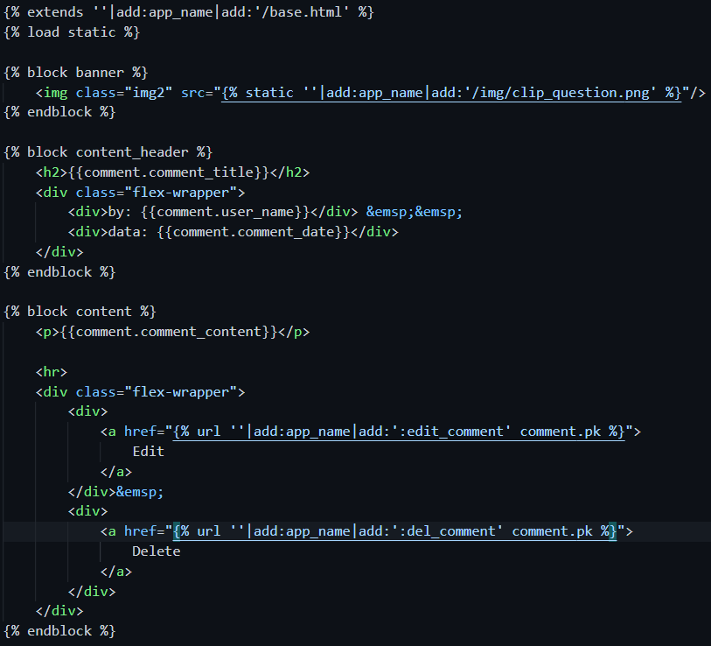
Detail comment

Slide 18
Add url conf
Comment details
Comment edit
Comment delete

Slide 19
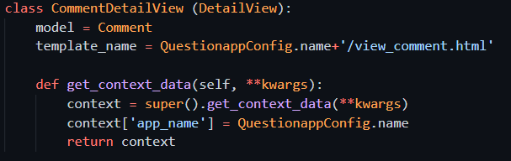
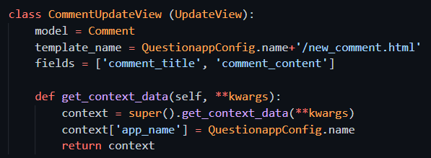
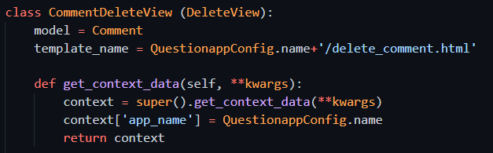
Add view
Comment details
Comment edit
Comment delete

Slide 20
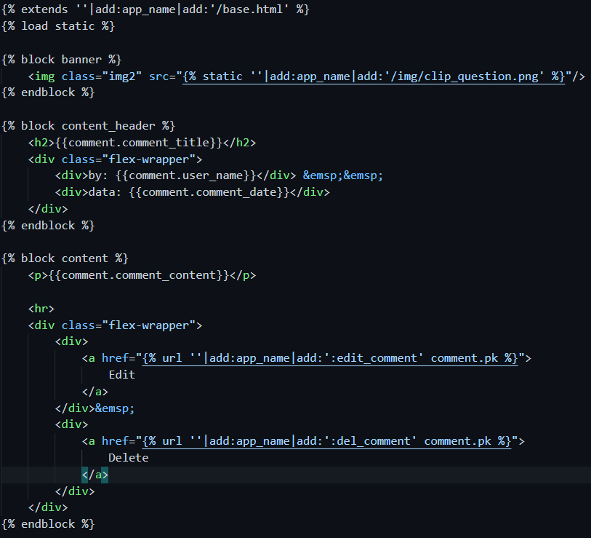
Add template
Comment details

Slide 21
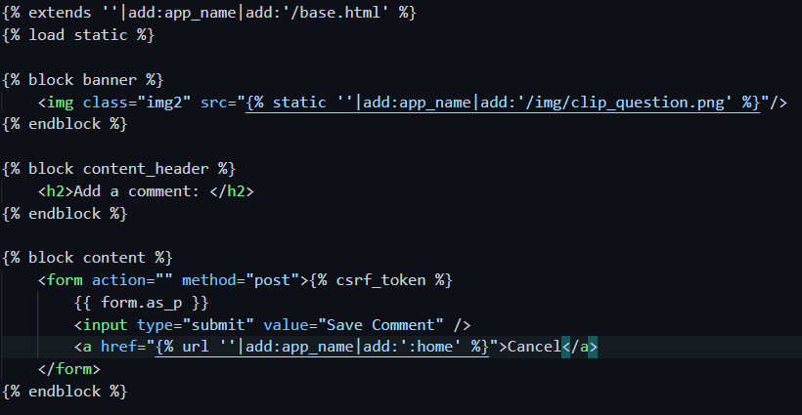
Add template
Comment edit. Same template as add new comment

Slide 22
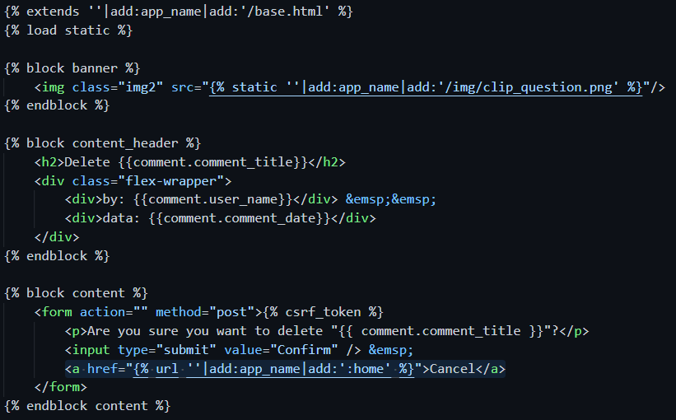
Add template
Comment delete
Add one additional cancel link

Slide 23

Still got one issue when delete
The model function get_absolute_url not working for this deleteview. So need add get_success_url function for the view.

Slide 24
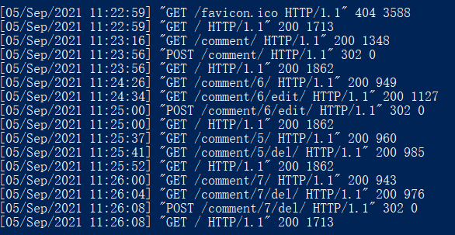
Check the details from server log
Click add comment, browser send this GET
Click on one comment and view the details.
Finish edit the form and click submit, browser send this POST. The add comment successful. Server respond 302
Click edit the comment.
Finish the edit of form, submit the result. Update comment success. Server responde 302
Go to the URL of get_absolute_url
Click one comment view details
Go to the URL of get_absolute_url
Click delete
Click on one comment and view the details.
Click cancel, it links to homepage
Click delete
Click confirm delete. Server process success, respond 302
Goto the URL of get_success_url. Because one comment deleted, so the size smaller.

Slide 25
Deploy to Heroku cloud
Push to git repo
Deploy to heroku
PS> cd QuestionPrj
PS> git status
PS> git add –A
PS> git commit –m “add comment function”
PS> git push origin main
PS> git push heroku main
PS> heroku ps:scale web=1

